Slide 1
Asymptotic Efficiency of Algorithms

Slide 2
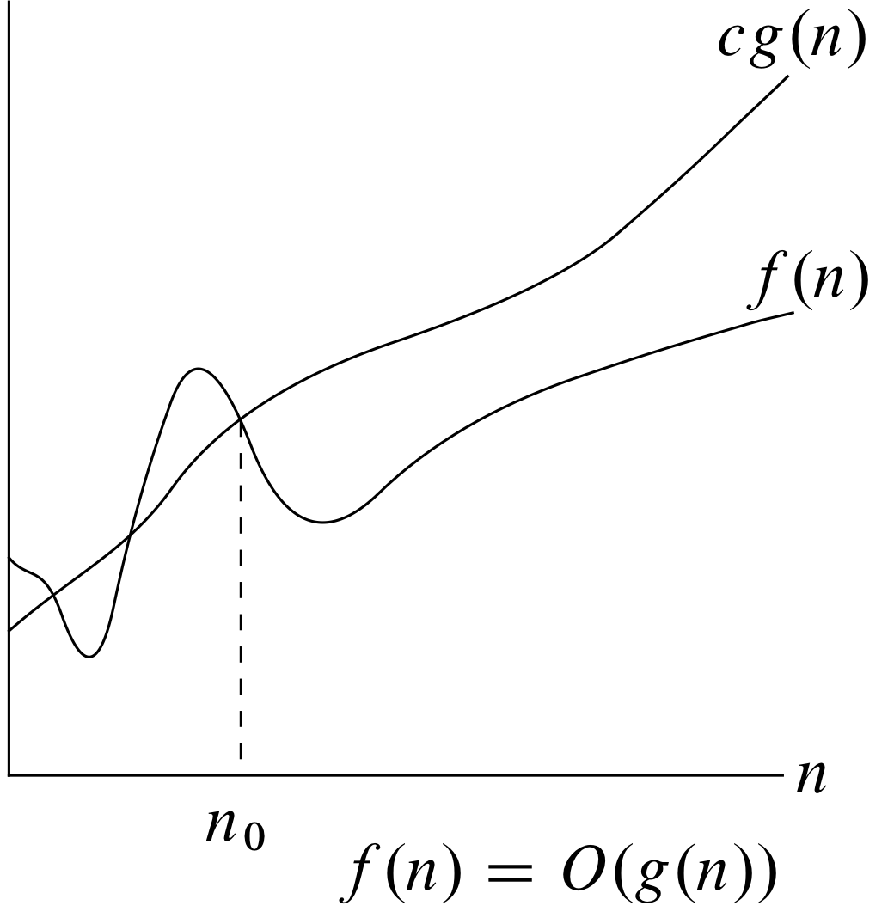
O notation

Slide 3
O-notation
The θ-notation asymptotically bounds a function from above and below
When we have only an asymptotic upper bound, we use O-notation.
For a given function g(n), we denote by O(g(n)) the set of functions O(g(n)) = { f(n): there exist positive constants c and n0 such that 0 ≤ f(n) ≤ cg(n) for all n ≥ n0}
So O-notation is used to give an upper bound.

Slide 4
o-notation
The θ-notation asymptotically bounds a function from above and below
When we have only an asymptotic upper bound, we use O-notation.
However, it may or may not be asymptotically tight.
The bound 2n² = O(n²) is asymptotically tight, but the bound 2n = O(n²) is not.
o-notation is used to denote an upper bound that is not asymptotically tight.

Slide 5
o-notation
For a given function g(n), we denote by o(g(n)) the set of functions o(g(n)) = { f(n): for any positive constant c > 0, there exist a constant n0 > 0 such that 0 ≤ f(n) < cg(n) for all n ≥ n0}
2n = o(n²) but 2n² ≠ o(n²)

Slide 6
o-notation
O-notation and o-notation are similar, except
In f(n) = O(g(n)), the bound 0 ≤ f(n) ≤ cg(n) holds for some constant c > 0, but
in f(n) = o(g(n)), the bound 0 ≤ f(n) ≤ cg(n) holds for all constants c > 0.
Intuitively, in o-notation the function f(n) becomes insignificant relative to g(n) as n approaches infinity lim
f(n)
n -> ∞
=
0
g(n)

Slide 7
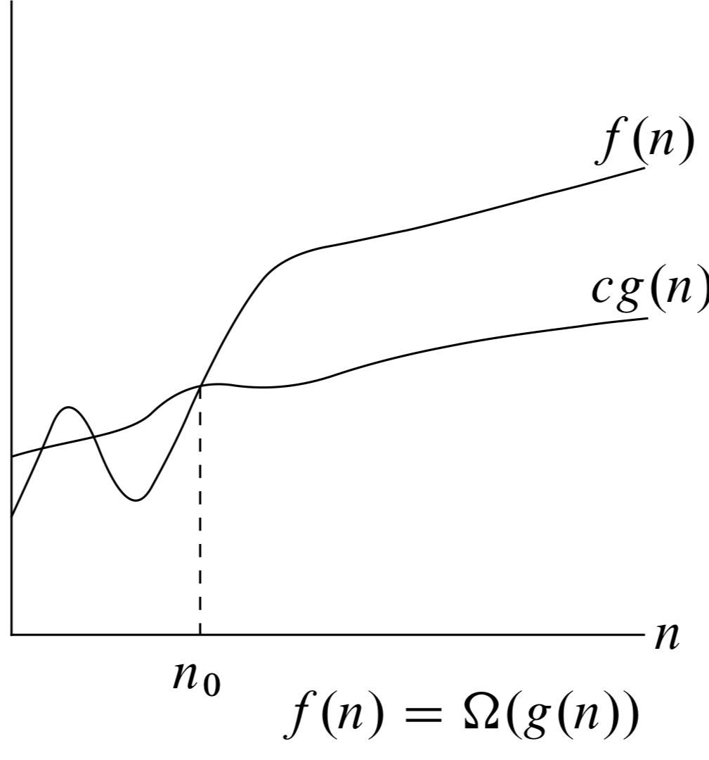
Ω-notation
For all values n at or to the right of n0, the value of f(n) is on or above cg(n)

Slide 8
Ω-notation
Ω-notation provides an asymptotic lower bound.
For a given function g(n) we denote by Ω(g(n)) the set of functions Ω (g(n)) = {f(n): there exist positive constants c and n0 such that 0 ≤ cg(n) ≤ f(n) for all n ≥ n0}

Slide 9
ω-notation
ω-notation is to Ω-notation as o-notation is to O-notation.
ω-notation denotes a lower bound that is not asymptotically tight.
ω(g(n)) is defined as the set ω(g(n)) = { ƒ(n): for any positive constant c > 0, there exists a constant n0 > 0 such that 0 ≤ cg(n) < f(n) for all n ≥ n0}
n²/2 = ω(n), but n²/2 ≠ ω(n²)
The relation ƒ(n) = ω(g(n)) implies that lim n–>∞
ƒ(n)
=
∞
g(n)

Slide 10
Rank the functions, according to their growth in the increasing order
1
n²
2^{n}
n³
(3/2)^{n}
n

Slide 11
Match functions if ƒ(n) = θ(g(n))
ƒ(n) g(n) n+30 n⁴ n²+2n-10 log2 2x n³ * 3n n²+ 3n log2 x 3n - 1

Slide 12
Asymptotic relationship
For the functions, lg n ^{lg 17} vs. lg 17 ^{lg n}, what is the asymptotic relationship between these functions? lg n ^{lg 17} is O( lg 17 ^{lg n}) lg n ^{lg 17} Ω(lg 17 ^{lg n}) lg n ^{lg 17} θ(lg 17 ^{lg n})

Slide 13
Asymptotic relationship
For the functions, lg n ^{lg 17} vs. lg 17 ^{lg n}, what is the asymptotic relationship between these functions? lg n ^{lg 17} is O( lg 17 ^{lg n}) lg n ^{lg 17} Ω(lg 17 ^{lg n}) lg n ^{lg 17} θ(lg 17 ^{lg n})
Αll three because lg a^{b} = b lg a

Slide 14
Asymptotic relationship
For the functions, n^{k} vs. c^{n}, what is the asymptotic relationship between these functions? Assume that k ≥ 1 and c > 1 n^{k} is O(c^{n}) n^{k} is Ω(c^{n}) n^{k} is θ(c^{n})

Slide 15
Asymptotic relationship
For the functions, n^{k} vs. c^{n}, what is the asymptotic relationship between these functions? Assume that k ≥ 1 and c > 1 n^{k} is O(c^{n}) n^{k} is Ω(c^{n}) n^{k} is θ(c^{n})
n^{k} is O(c^{n})

Slide 16
Asymptotic relationship
For the functions, lg n vs. lg8 n, what is the asymptotic relationship between these functions? lg n is O(lg8 n) lg n is Ω(lg8 n) lg n is θ(lg8 n)

Slide 17
Asymptotic relationship
For the functions, lg n vs. lg8 n, what is the asymptotic relationship between these functions? lg n is O(lg8 n) lg n is Ω(lg8 n) lg n is θ(lg8 n)
All three are true

Slide 18
Asymptotic relationship
For the functions, n³ lg n vs. 3n lg8 n, what is the asymptotic relationship between these functions? n³ lg n is O(3n lg8 n) n³ lg n is Ω(3n lg8 n) n³ lg n is θ(3n lg8 n)

Slide 19
Asymptotic relationship
For the functions, n³ lg n vs. 3n lg8 n, what is the asymptotic relationship between these functions? n³ lg n is O(3n lg8 n) n³ lg n is Ω(3n lg8 n) n³ lg n is θ(3n lg8 n)
n³ lg n is Ω(3n lg8 n)

Slide 20
Asymptotic relationship
For the functions, 8^{n} vs. 4^{n}, what is the asymptotic relationship between these functions? 8^{n} is O(4^{n}) 8^{n} is Ω(4^{n}) 8^{n} is θ(4^{n})

Slide 21
Asymptotic relationship
For the functions, 8^{n} vs. 4^{n}, what is the asymptotic relationship between these functions? 8^{n} is O(4^{n}) 8^{n} is Ω(4^{n}) 8^{n} is θ(4^{n})
8^{n} is Ω(4^{n})

Slide 22
Comparison on O and Ω
2n ε Ω(n) and n ε O(2n)
n² ε Ω(n) and n ε O(n²)
n² ε Ω(3n²+n lg n) and 3n²+ n lg n ε O(n²)

Slide 23
Function Growth in the increasing order
Function common name O(1) constant ⊂ O(log n) logarithmic ⊂ O(log² n) log-squared ⊂ O(√n) root-n ⊂ O(n) linear ⊂ O(n lg n) ⊂ O(n²) quadratic ⊂ O(n³) cubic ⊂ O(n⁴) quartic ⊂ O(2^{n}) exponential ⊂ O(e^{n}) exponential

